Slide 1



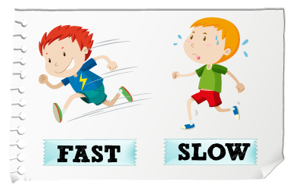
Project Title : Fast Play.
Presented By
Fahim Muntasir Sumit
ID:193-15-13459.
Section; D.
Python Project Presentation

Slide 2
Outline
Objective
Working Procedure
Project User Interface
Input Output Demo
Expected Outcomes
Conclusion
Python Project Presentation

Slide 3
Objective
This project is very funny and helpful. The main objective of our project is to helping people, who always want to type fastly. There are many such game available in the market. But this game will take little space in your storage. And people can operat easily. This game will need a small time for data processing. So it will work fastly.
Python Project Presentation

Slide 4
Working Procedure
All Librarys, Modules and Functions:
def welcomeLabel()
def startPlay()
def timer()
def bg_music()
def volume(vol)
def mute()
def unmute()
Tikinter Library
Massagebox Module From Tikinter Library
Random Module
Mixer Module From Pygame Library
Python Project Presentation

Slide 5
Working Procedure
Tikinter Library for GUI.
Massagebox Module From Tikinter Library for sending alert massage.
Random Module for showing words randomly.
Mixer Module From Pygame Library for controlling background music.
def welcomeLabel() Function for showing welcome massage with animation.
def startPlay() Function is the main part of this project. It controlling result part, words management etc.
def timer() Function for showing time and when time is up, it show alert massage and remove all data.
def bg_music() Function for playing a sweet music in backgroung. When the music is finished, it play that’s music again.
def volume(vol) Function for setting the volume scale.
def mute() Function for muting background music.
def unmute() Function for unmuting background music.
Python Project Presentation

Slide 6
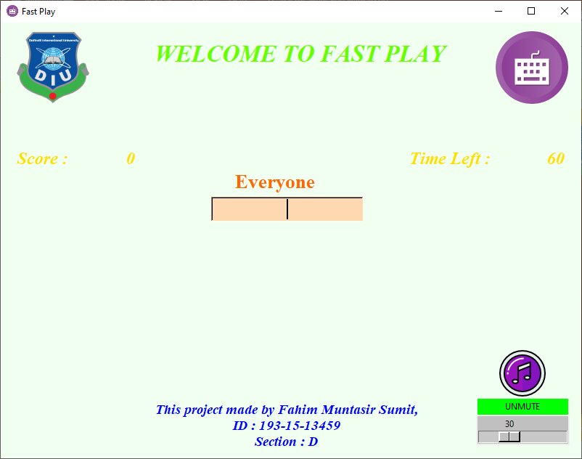
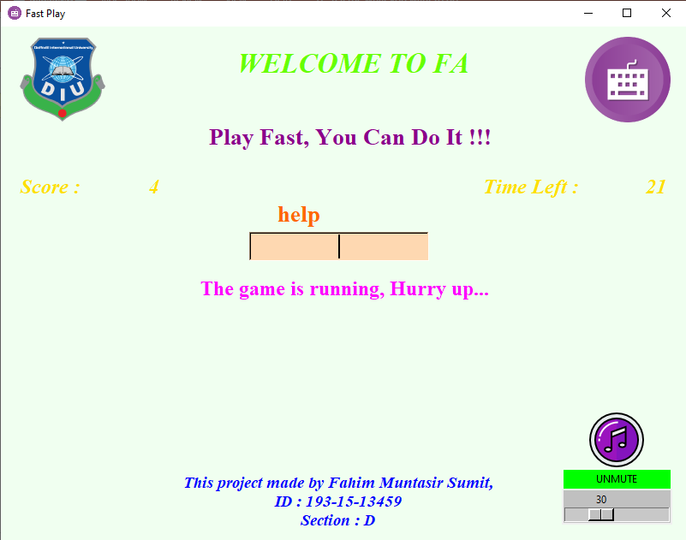
Project User Interface
When we open this project, we can see this window and listening a sweet music. If you don’t like this music, you can mute or unmute and also doing volume up an down
When we started typing then we can see 2 motivational speech, time and score.
Python Project Presentation

Slide 7
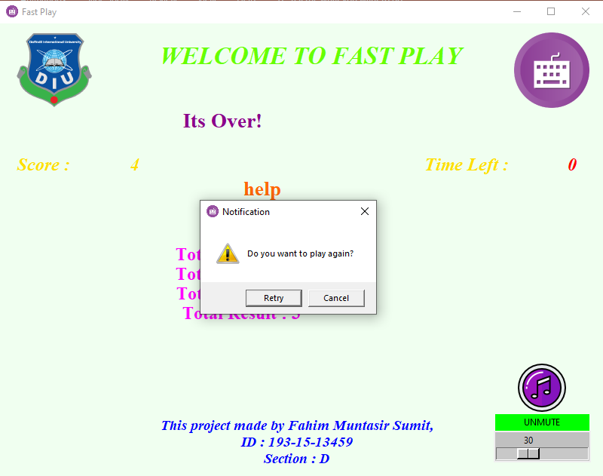
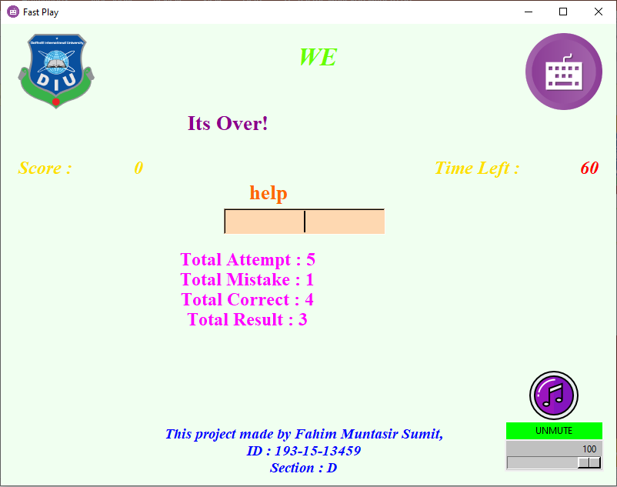
Project User Interface
When time is up then we can see a alert massage. If you can play one more time so press Retry button. And enjoying this game again.
So, if we choose any one option, then it showing our result…
Python Project Presentation

Slide 8

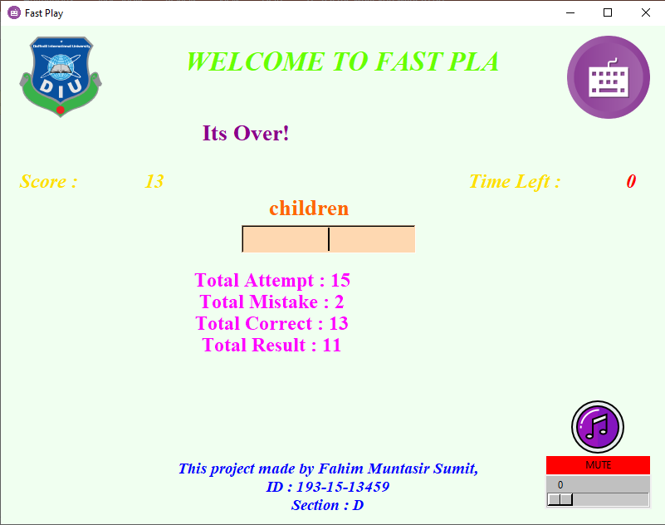
Input Output Demo
We can see the random words and we can trying for typing those words. And also can mute the sound or controlling volume.
Our output is the result of our typing skill.
Python Project Presentation

Slide 9
Expected Outcomes
In this time everyone must should be learn fastly typing with correctly. So this game on of the best way for lean it. Its is a funny game. So you never be bore. You can listen a beautiful music and playing this game. If you play this game regularly, you get a good typing skill.
Python Project Presentation

Slide 10
Conclusion
The main goal of my project is to helping people, who always want typing fastly. So it is a game. People can play easily. Its need a small place in your storage. So it is vary light weight. We can see some random words and we can trying for tying it in one minute. And at last we can see our result. If we play this game regularly, so we get a big achievement. Which will help a lot in our job field or our daily life.
Python Project Presentation

Slide 11


Thank You
Python Project Presentation

